Slide 1
Workshop for Solution Development
Chapter 16

Slide 2
READ ME!
This is an example slide deck for running the ‘Workshop for Solution Development’, described in Chapter 17.
This slide deck is bland. This is intentional. In this way, you can see the message that you need to get across in each slide, without distracting animations, colours, or images.
It is up to you to modify this slide deck to your own needs and preferences.
My own preferred style is to have few words, concepts, and images on a slide. This allows the users to focus upon what you are saying in the room.
To understand what you should be saying at that point in the slide presentation READ THE NOTES FOR THAT SLIDE. Notes typically are displayed underneath the main window.
You will need to modify this slide deck more than the previous deck (for problem understanding). This is because you need to incorporate your findings from the first workshop and subsequent investigations into the deck. Those finding will be unique to your organisation.

Slide 3
Agenda
Notes:
Provide a suitable agenda.
The following 2 slides give a suggested agenda for 2-days and 1-day respectively.
Delete the one that is not appropriate to you and then modify the remaining one, so that it matches your final agenda and slide deck.

Slide 4
Agenda
Recap & update (105 minutes)
Causes of technical debt (30 minutes)
Findings from 1st workshop & further investigations (30 minutes)
Summary of analysis (15 minutes)
Addressing existing debt vs avoiding new debt (15 minutes)
Simulation update, if applicable (15 minutes)
BREAK (15 minutes)
Explore 1st candidate intervention (90 minutes)
Select candidate intervention (15 minutes)
Facilitated discussion and activities (60 minutes)
Useful workshop techniques (15 minutes)
LUNCH (60 minutes)
Explore 2nd candidate intervention (90 minutes)
BREAK (15 minutes)
Explore 3rd candidate intervention (90 minutes)
Summary and Next Steps (15 minutes)
Notes:
This is an example agenda for a 1-day workshop for Solution Development for Technical Debt.
Day 1 – If you start at 9:00, you will be finished at 17:15.

Slide 5
Recap & update
Notes:
Avoid a big "roundtable" introduction, where everybody speaks for a minute or two. This approach can easily suck 30 minutes out of your schedule before you even notice it.

Slide 6
Recap & update
Causes of technical debt (30 minutes)
Findings from 1st workshop & further investigations (30 minutes)
Summary of analysis (15 minutes)
Addressing existing debt vs avoiding new debt (15 minutes)
Simulation update, if applicable (15 minutes)

Slide 7
Causes of technical debt
Notes:
Aim for about 30 minutes for this section.
You will not have time to go through every item on the following slides in 30 minutes, so be selective in your material
Aim to make this session as interesting and engaging as possible.
Try organising it like a small quiz.
Get individuals to break out into small groups, say four people, then pose the points as a series of questions.
If you're feeling truly organised, try printing out some answer sheets.

Slide 8
The technical debt onion
?
?
?
?
?
Notes:
Begin by asking the question, "Is technical debt a technical problem"?
Hopefully, the entire workshop should answer "No!"
Next, ask what is the technical debt onion, then get the groups to write down the names of each of the layers of the onion.
Participants may find this hard, particularly if the has been some time between the two workshops. Hence, you might need to give some clues, for example:
"Outside layer – what kind of problem is technical debt definitely not?"
Answer: a technical problem. A clue to the technical layer.
"Next layer – what kind of problem is technical debt?"
Answer: a trade-off problem. The trade-off layer.
"Next layer – what might stop someone making the best decision for the organisation… Their role in the system."
Answers into the systems layer.
And so on

Slide 9
Technical
Trade-off
Wicked Problems
Economics/ Game Theory
Systems
Notes:
Reveal the layers of the onion.

Slide 10
Trade-off decisions
How do we make trade-off decisions? – Affect heuristic
What does the affect heuristic use? – Our current emotional state.
When does it go wrong? – When one side of the trade-off does not influence the affect heuristic.
When might we value a music dictionary with 10,000 entries or highly than one with 20,000 entries? – Under separate evaluation, if the larger dictionary has cosmetic damage.
Some requirements for an effective decision-making mechanism, used in our ancestral past – fast, functioning well with poor quality information, impose low cognitive load.
When we trade off technical debt against the new feature, what are the characteristics of each? – New feature: immediate, certain, concrete, experienced by us, emotional. Technical debt future, uncertain, intangible, experienced by others, rational.
Notes:
Use this slide, plus the following slides, as a source of your questions to recap the workshop attendees on trade-off decisions.
Don’t forget to modify for your own use.

Slide 11
Trade-off decisions
Identify a trade-off similar to technical debt, but in healthcare. – Smoking prevention programmes.
How did health authorities address the problem of teenagers choosing to begin smoking? – 1/shifted arguments about disadvantages away from rational messages towards emotional messages. 2/prevented tobacco manufacturers using emotional messages on cigarette cartons.
What are the implications for technical debt? – You must shift technical debt arguments away from logic and towards emotion.
How can you appeal to emotions through a story?
What is valence and precision, and why is it important to the technical debt problem? – If a characteristic lacks precision, like technical debt's characteristics, it will not influence the affect heuristic.

Slide 12
Trade-off decisions
What is a Ulysses contract? – It is a contract that we enter into freely, but will bind us under certain conditions in the future. Often known as a living will.
What are simultaneous verses sequential decisions? Simultaneous decisions are made all at once, whereas sequential decisions are made as a sequence.
Give an example of improved decision-making using simultaneous verses sequential decisions. – Healthy eating in the lunch canteen.
What is the premortem technique? Project yourself into a future scenario to improve your ability to identify unanticipated risks or problems.
Why do overdue projects take crazy risks? – Overdue project switch from conditions of gains to conditions of losses. This causes a switch in risk appetite, from risk adverse to risk seeking.
What is the effect of time constraints on making decisions? – Under time pressure, we tend to use the subconscious affect heuristic, rather than rational decision-making.
What is hyperbolic discounting? – A tendency to have a stronger preference for more immediate payoffs, relative to later payoffs.

Slide 13
Technical
Trade-off
Wicked Problems
Economics/Game Theory
Systems
Notes:
Next, tell attendees that you will now be recapping systems effects

Slide 14
What is a system?
A system is a set of elements or parts
that is coherently organised and interconnected
in a pattern or structure
that produces a characteristic set of behaviours,
often classified as its ‘function’ or ‘purpose’.
Notes:
Begin by asking the workshop what is meant by a system.
Next, show Donella Meadows' definition of a system, as shown on the slide.
Next, identify the three crucial characteristics of a system.
Parts. Something that has only one part, such as a ball, is not a system.
Interconnected parts. A lead weight and a piece of string are not a system. But if you connect the lead weight to the string and suspend it from the ceiling, then you have a pendulum system.
The structure of the interconnections produces a characteristic set of behaviours or patterns. For example, the pendulum produces a regular, periodic motion, where the length of the string determines the period of the motion.
Next, get the slinky out and remind people of the demo by Donella Meadows.

Slide 15
Systems effects
What is a crucial difference between IT systems and social systems? – Social systems contain subsystems, or actors, that can determine the own goals. This leads to conflict.
What happened when the United States introduced prohibition? – Experienced and anticipated effects, namely the growth of organised crime.
How might individuals pursuing their own goals whilst working within a system drive technical debt?
Individuals constrained by role
Overdue projects and schedule recovery
Project underestimation
Overshoot and collapse
Policy resistance

Slide 16
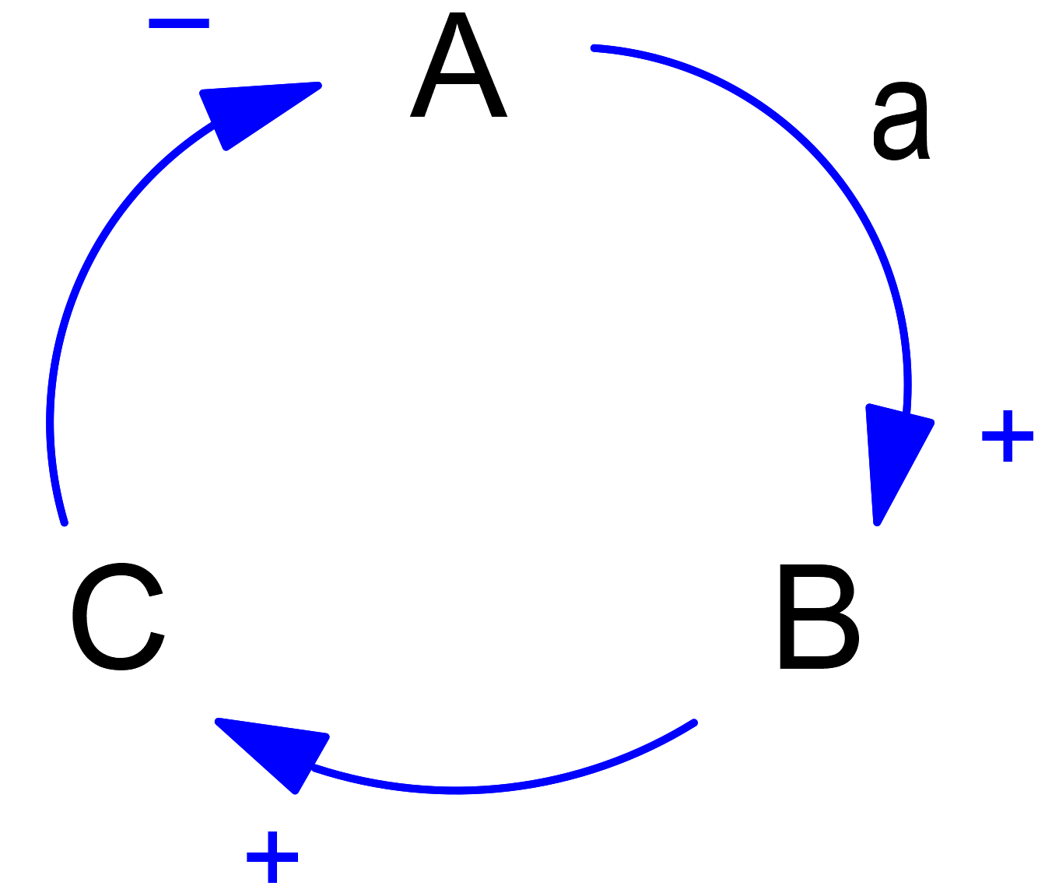
Anti-patterns
What type of diagram is this? – a causal loop diagram

Slide 17
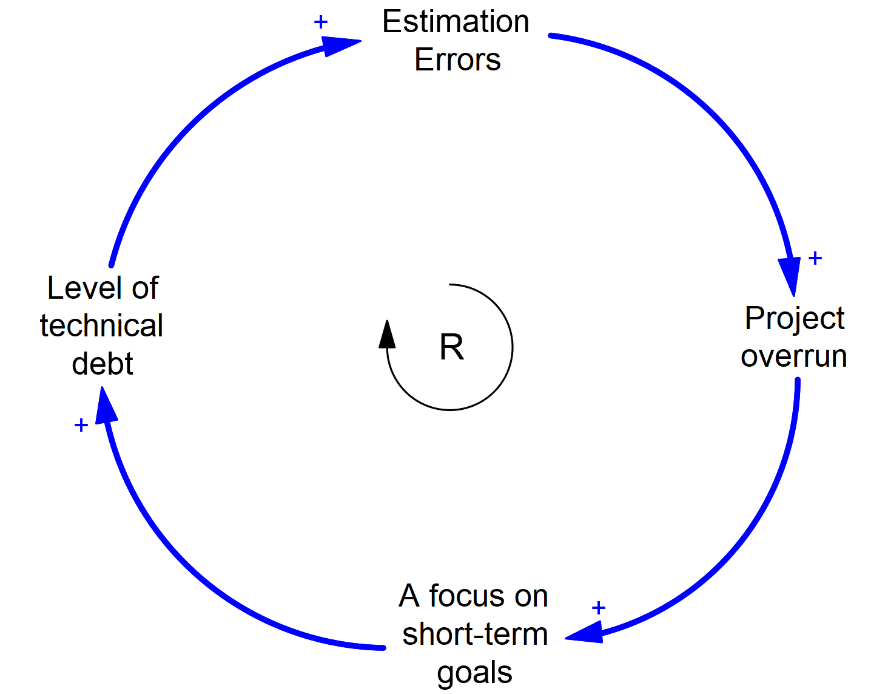
How might estimation errors lead to a self-reinforcing loop?

Slide 18
Technical
Trade-off
Wicked Problems
Economics/ Game Theory
Systems
Notes:
Next, tell attendees that you will now be recapping economics effects

Slide 19
Principal-agent problem
Tragedy of the commons
Externalities
Short-termism
Tyranny of small decisions
Creeping normality
Price of anarchy
Moral hazard
Notes:
Ask attendees to write down meanings/definitions for the above economic problems;
Principal-agent problem. The people who do the work and the people who want work done have different objectives, leading to a conflict of interests
Tragedy of the commons. It’s rational to take as much as you can from a common resource if you don’t pay the consequences of that extraction. This leads to resource destruction, despite nobody wanting that to occur.
Externalities. This is where one party can impose costs upon another without the other party having a say in the matter.
Short-termism. What is in an agent’s short-term interests is different from their long-term interests.
Tyranny of small decisions. Lots of small decisions add up to a larger, bad decision, one that we probably wouldn’t have made.
Creeping normality. A major change can be accepted as normal, provided it happens gradually through small increments.
Price of anarchy. There is often a substantial price to pay for allowing multiple agents to act in their own self-interest.
Moral hazard. When people who benefit from taking a risk are divorced from the consequences of their actions, risk-taking increases and bad things happen.

Slide 20
Technical
Trade-off
Wicked Problems
Economics/Game Theory
Systems
Notes:
Next, tell attendees that you will now be recapping wicked problems

Slide 21
Characteristics of a wicked problem
You cannot understand the problem until after you have found a solution.
Stakeholders have radically different worldviews and different frames for understanding the problem.
How you currently understand the problem determines what you will try as a solution.
Solutions to wicked problems are not true-or-false, but better or worse.
You do not have an immediate and conclusive test to see if your solution has worked.
Every solution to a wicked problem is a "one-shot attempt”.
Wicked problems are interconnected with other wicked problems.
You have no way of knowing when to stop.
Notes:
Ask attendees to identify eight characteristics of a wicked problem.
Next, reveal the above list.

Slide 22
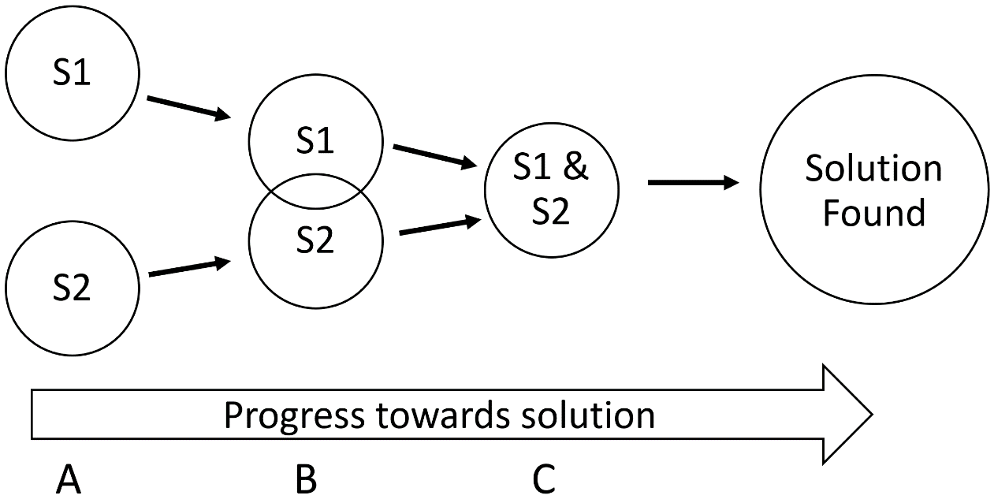
Social complexity and fragmentation
Notes:
Ask – what is social complexity and fragmentation.
Next, show them the above diagram.
Also, ask them what is shared understanding and why it is so important.
Emphasise that shared understanding does not mean that different specialisms agree with each other on all aspects of technical debt, but rather that all specialisms have sufficient understanding of each other and their problems that they can have an intelligent conversation about how to address the issue.

Slide 23
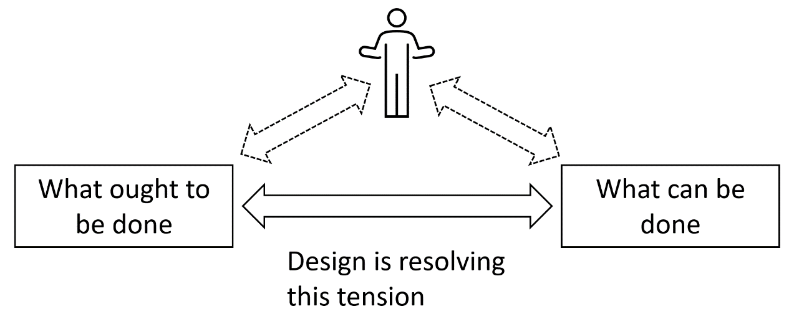
Dichotomy of design
Notes:
Ask attendees what is meant by the dichotomy of design.

Slide 24
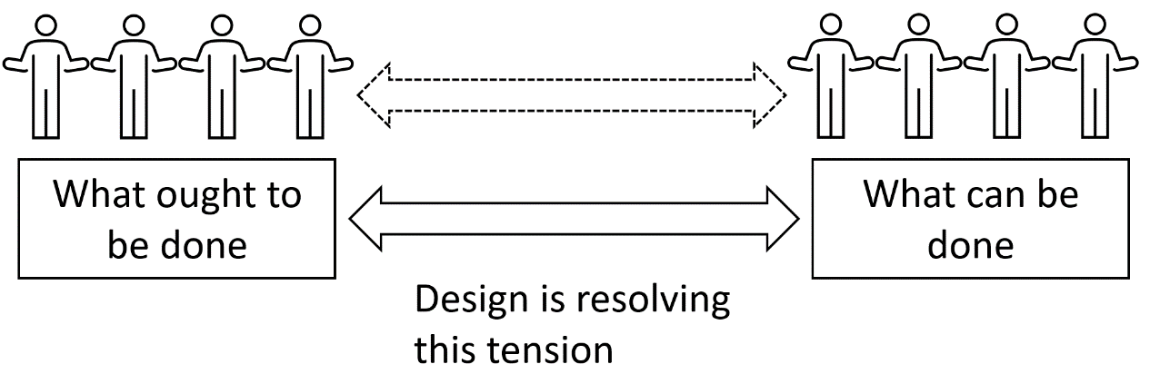
Dichotomy of design
Notes:
Ask attendees what it is about an organisation structure that leads to fragmentation
Answer: an organisation is typically structured so that individuals perform distinct roles, and those distinct roles usually put us into one side or the other of that dichotomy. Rarely do we stand on both sides of that dichotomy.

Slide 25
Findings from 1st workshop & further investigations
Notes:
Aim to spend around 30 minutes in this section

Slide 26
Findings from 1st workshop
<Insert onto this slide the findings from your first workshop – problem understanding.>
You should have tentative results that may include the following:
the factors driving technical debt creation
factors making technical debt unnecessarily worse
any mitigating factors, which you do not wish to lose
project factors, such as schedule overrun, influencing decision-making
system factors and organisational setup influencing debt
economics problems, for example principal-agent problem, tragedy of the commons
wicked aspects of the problem
how social complexity and fragmentation may inhibit getting to a solution
Notes:
Create one or more slides to display the tentative results from that first workshop.
You are probably best off putting each result/finding on a separate slide.
As you display your slides, ask people to think about which topics they consider would be most important/fruitful to investigate in the later sessions.
In this and the subsequent slides, you are actually doing more than simply presenting those findings.
This is also an opportunity to begin shaping the direction of this workshop.
You can emphasise the areas that you think are more important or fruitful, and give less emphasis on other areas.
To enhance engagement from workshop attendees, consider allowing part of the results/presentation to be delivered by team members relevant for that area.
However, bear in mind time constraints and also the risk of wandering in undesirable directions.

Slide 27
Findings from further investigations
<Insert onto this slide the findings from the subsequent investigations following your first workshop – problem understanding.>

Slide 28
Summary of analysis
Notes:
Aim to spend around 15 minutes in this section

Slide 29
Summary of analysis
Notes:
Prepare a summary of your own analysis, which should also include the analysis and summary of talking to the stakeholders during your investigations.
This summary should include tentative identifications of the major drivers of technical debt, plus where the workshop should consider focusing its efforts to be most fruitful.
This summary is a good opportunity to begin or continue shaping the direction of this workshop.
Emphasise those areas that you or the stakeholders considered important.
However, be prepared to modify/abandon this summary if the discussion from the findings of the first workshop and further investigations (that you are just conducted) suggests a more fruitful direction.

Slide 30
Addressing existing debt vs avoiding new debt
Notes:
Aim to spend around 15 minutes in this section

Slide 31
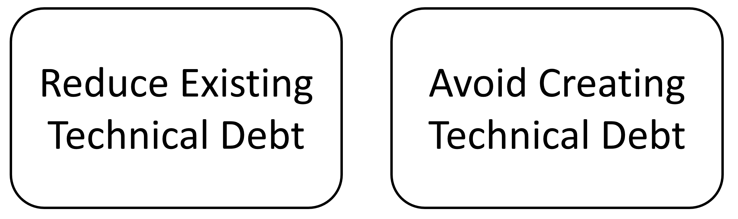
Addressing existing debt vs avoiding new debt
Notes:
Identify to attendees that there are two approaches to reducing technical debt.
The first, and most common approach is to identify existing technical debt items and then tackle them.
Point out the benefits and limitations of this approach.
Consider using an analogy to a water leak. If you're a small leak, an intermittent dripping that occurred under certain conditions, then in addition to removing the water you would also be well advised to fix the leak.
If the leak was a one-off, then you would not need to worry about avoiding future leaks, but could concentrate on removing the existing water.
Explain why you will need to address both the reduction of existing technical debt plus also avoiding the creation of future technical debt.
Point out the problems you are likely to have if you focus on just one of the other.

Slide 32
Simulation update (if applicable)
Notes:
Aim to spend around 15 minutes in this section, if you have any dynamic modelling simulation results to demonstrate.

Slide 33
BREAK

Slide 34
Explore 1st candidate intervention
Notes:
Aim for 90 minutes for this session.

Slide 35
Explore 1st candidate intervention
Select candidate intervention (15 minutes)
Facilitated discussion and activities (60 minutes)
Useful workshop techniques (15 minutes)

Slide 36
Select candidate intervention
Notes:
Aim to spend no more than 15 minutes on this activity, on the 1st candidate intervention.
For subsequent selections, aim for less time, ideally no more than 5 minutes.

Slide 37
Select candidate intervention
<List of candidate interventions.>
Notes:
By this stage of the workshop, you should have a list of candidate interventions to investigate further.
Some of these candidate interventions will come from the output of the first workshop session or the subsequent additional information gathering. Since these both occurred some time ago, you can have already prepared these items, plus relevant/salient information.
Other candidate items will have come out from the earlier discussions in this workshop session – either whilst discussing the findings from the workshop & investigation, or in the summary of analysis.
You can either quickly add these to the list on this slide, or if you are working from a whiteboard, then add it to the whiteboard.
Go through each of the candidate intervention items and ensure that workshop attendees understand each item.
Now, you want to get workshop attendees to decide which candidate intervention they would like to work on first.
The simplest way is to use something like 'dot voting', where each attendee is assigned a given number of votes or dots, and they assign those to their preferred candidate item. If you're not familiar with dot voting, then you can find out more, either in Red Teams, Liberating Structures, or similar sources.
Once everyone has voted, count up the votes, then work on the item with the highest number of votes.
While you are counting up those votes, also note down the second and third most popular choices. This may save you time later in the workshop, when you look at the second and third candidate interventions (although attendees may change their mind as to the preferences as a result of what they learn during this session).

Slide 38
Facilitated discussion and activities
Notes:
Aim to spend around 60 minutes in this facilitated discussion and related activities.

Slide 39
Facilitated discussion and activities
Notes:
This session will require all of your facilitation skills, or the skills of whoever is facilitating. If you are not confident that you can facilitate this session effectively, then consider other options:
A skilled and well briefed facilitator.
Practice with a small, friendly group beforehand.
Get one of the senior stakeholders to support you or lead the facilitation.
At this point, the workshop attendees have selected the candidate intervention, so you are exploring what that intervention may look like.
Start by getting the workshop to create a statement of the intervention, then get agreement on it. For example, if the workshop was deemed that the biggest problem is caused by Project underestimation and the organisation is willing and able to address that problem, then your problem statement may be something along the lines of "Project underestimation leads to Project overrun, which then leads to the creation of technical debt. This organisation will improve project estimation, until it is no longer a factor in technical debt creation."
Once you have a problem/intervention statement, next generate a list of potential approaches to a solution.
Combine the technique of 1-2-4-All with brainstorming to generate ideas. First, get people to spend a couple of minutes thinking of potential solution approaches. Next, combine into pairs and discuss. Next, combine the pairs into fours and discuss the ideas. As you are discussing, additional ideas should come out, which you should record down. Finally, combine the workshop altogether and record down on a whiteboard or other common area, all of the ideas the individuals and groups have generated.
Do not reject any ideas at this stage.
Take a brief break, then use dot voting to vote for the most promising idea to take further.
Use whatever techniques you find useful or comfortable to explore this idea. Potentially useful techniques include:
Edward DeBono's PMI (plus, minus, interesting).
Wicked questions (liberating structures)
TRIZ (liberating structures, red teams).
Imagining an alternative.
Dialogue mapping/argument mapping (Jeff Conklin).
9 Whys (liberating structures).
You will probably find it most useful to go through several iterations of breaking into small groups discussing an issue, then reforming as the whole workshop. In this way, you can get the benefit of multiple fresh ideas, whilst ensuring that the most relevant or important ideas are shared with all.

Slide 40
Useful workshop techniques
Notes:
Spend around 15 minutes on this activity.
If you find yourself overrunning from the facilitated discussion, then you can drop this session and go straight into the break/lunch.

Slide 41
Useful workshop techniques
Wicked questions
TRIZ
PMI
Chesterton's fence
Imagine an alternative
9 Whys
Dialogue mapping/argument mapping
Notes:
This section is a placeholder for you to create slides for workshop techniques that you find useful and wish to introduce to the workshop attendees.
The above list is merely an example list. You should add or remove from that list, according to your own preferences.
I have put all these potential techniques in one place for convenience. However, I do not recommend having a dedicated or focused session, where you go through each of these techniques. Instead, introduce the workshop to these techniques as a 'drip feed' approach, when you judge that conditions within the workshop are appropriate.
Remember, each of the slides is merely a placeholder, for you to amend and fill in further.

Slide 42
Wicked questions
Example wicked question:
"How is it that you are raising your children to be very loyal/attached to the family and very independent individuals simultaneously?
Notes:
For more details of wicked questions, refer to the book, 'Liberating Structures', or the website.
Explain to workshop participants the idea of wicked questions – where you articulate the paradoxical challenge of a group must confront to succeed.
Next, get the workshop to practice with an example wicked question. An example from the liberating structures book is, "How is it that you are raising your children to be very loyal/attached to the family and very independent individuals simultaneously?"
After practising with an example, get the workshop attendees to suggest that own wicked questions related to technical debt (use 1-2-4-All). Next, use dot voting to select the most popular wicked question, then get the workshop to break down into small teams (or use 1-2-4-All) to explore the question.
Don't forget to record the ideas on post-its and put into a common area.

Slide 43
TRIZ
Notes:
For more details, refer to the book, 'Liberating Structures', or the website.
TRIZ is about stopping counter-productive activities and behaviours it is ideally suited to the context of technical debt.
Once again, if participants are not familiar with the TRIZ technique, briefly explain the technique, then spend time walking through an example.
Begin by explaining that we are trying to identify all the things that we must stop doing to make progress on technical debt.
Explain that we will do this by identifying all the things that we could do to ensure the worst possible outcome with respect to technical debt.
If you would like to, give the participants a potentially humorous example. For myself, I might suggest – ‘how could I absolutely guarantee that my two daughters will one day dump me in a horrible old People’s home and never come visit me?’ Suggestions could be items such as:
Always forget their birthdays.
Mix the names up.
Get really cranky as you get older.
And so on.
If you feel the workshop participants need a warmup, get them to divide into pairs and work on a non-threatening example for two minutes.
Now, do this for real. Get the workshop to break into groups of 4 – 7. Set the workshop participants the following question, or a similar, more focused one:
“How can we make sure we build an IT system that is so full of technical debt that we cannot make any modifications without doing major rework?”
If you want the workshop to come up with their own question, let them brainstorm for a few minutes then choose their preferred question.
Get each group to use the 1-2-4-All technique to create a first list of all the things it could do to ensure that it achieves this unwanted result. (10 minutes.)
Now get each group to use the 1-2-4-All technique to create a second list, this one of items that resemble items in the first list. (10 minutes.)
Next, get each group to look at each item on the second list and determine what steps they can take that will help stop this unwanted activity.
Finally, get each group to showcase their results to the rest of the workshop.
Be prepared for some controversy over items, when the groups discuss their results. For example, if one group has come up with a first list result like, ‘Never fund project unless it is badly underestimated’, individuals in other groups who are closely associated with the estimation may seek to counter with comments about how difficult it is to correctly estimate project.
Just how far to allow these discussions to go is very much a judgement call for yourself. You do want these contradictions to be surfaced. However, once surfaced and captured, you should avoid spending too much time, energy, and goodwill circling around the same issue.

Slide 44
PMI
Notes:
PMI is from Edward DeBono. It means plus, minus, interesting.
The idea is that you take an idea or suggestion then consider the positive aspects of it, the negative aspects of it, then the interesting aspects of it.

Slide 45
Chesterton's fence
<Image of a fence here>
Notes:
Before everybody in your workshop gets too carried away about removing things, you need to offer a word of caution. Two words, actually. Chesterton’s fence.
If you have time, talk the workshop participants through an anecdote of Chesterton's fence. Either use one from your own experience, or use the anecdote given in the book.
Show the workshop participants a slide depicting a fence that cuts across a road for no obvious reason, then use it to explain the concept of Chesterton’s fence. Follow this with a slide containing Chesterton’s quotation:
“In the matter of reforming things, as distinct from deforming them, there is one plain and simple principle… Let us say, for the sake of simplicity offence or gate is directed across a road.
The more modern type of reformer goes gaily up to it and says, ‘I don’t see the use of this; let us clear it away.’ To which the more intelligent type of reformer will do well to answer: ‘if you don’t see the use of it, I certainly won’t let you clear it away. Go away and think. Then, when you come back and tell me that you do see the use of it, I may allow you to destroy it’.”
G. K. Chesterton.
Chesterton’s fence is the principle that changes should not be made until the reasoning for the current set-up is fully understood.
Next, caveat the above sentiment by pointing out that within IT there are lots of things that are there for reasons that no one in the organisation can remember. However, unlike Chesterton’s fence, there are often no longer any good reasons for having the fence present.
Get the team to spend 10 minutes in a 1-2-4-All to discuss this conundrum and, with potential approaches. Capture the potential approaches on a whiteboard or post-it notes.

Slide 46
Imagine an alternative
Notes:
Your workshop now has the following outputs:
Your list of wicked questions, plus any insights and possibilities that have revealed themselves through the question exploration.
Your first list, of ways to achieve the unwanted result, plus your second list, of items the organisation does that resemble the first list.
Insights and comments from demonstrating the dynamic models.
Now your workshop is ready to begin imagining ways of working that will result in less technical debt.
Use the output from the earlier sessions to construct a whiteboard list of candidate solutions. Remember, technical debt is a wicked problem that has probably built up within your organisation over a long period of time. Moreover, its buildup has enabled individuals in the organisation to benefit, including some of those in the room now. Therefore, you are looking for new ways of working, rather than apportioning blame.
Also, you are not going to solve all the organisation’s technical debt problems either instantly or painlessly. What you can do though is take a step towards reduced technical debt, even if it is a small step.
Once you have created the list of candidate solutions, ask the workshop members to evaluate the solutions against a set of criteria. You can create your own, or use a list like the one below:
Impact.
Ease of doing.
Coordination with others required.
Risk.
Budget required.
Long-term/short-term.
At this point, you are probably trying to create some momentum that will enable the organisation to see some benefits and justify further work on technical debt reduction.
Therefore, get the workshop group to focus on items that are within the discretion to do, not things they cannot change. You are aiming to embody people with a sense of agency, that they are capable of changing things. You wish to avoid feelings of helplessness or powerlessness.
Next, ask workshop, “Is there anything else we can do? Something that doesn’t require permission of anyone?” Wait in silence for several seconds before moving on. Most people are uncomfortable in a silence, so there will be strong pressure to think of something that can be done. When that happens, thank the person for the contribution, write it down, then look expectantly and ask, “And what else?”
If you are fortunate, you will now have a decent list of small things that can be done to reduce technical debt, preferably with names against them.

Slide 47
9 Whys
Notes:
For more details, refer to the book, 'Liberating Structures', or the website.
This technique is used to make the purpose of your work together clear.
Begin in pairs, then groups of four, then the entire workshop.
After you have paired up, ask your partner, "when working on <item> what do you do?
Ask "why" questions until you make a discovery about your partner's most basic purpose.
Switch roles and then repeat.
Move to a group of four,, discussing similarities and differences.
Return to the whole group, and share your discoveries. Make a note if a group purpose becomes clear.

Slide 48
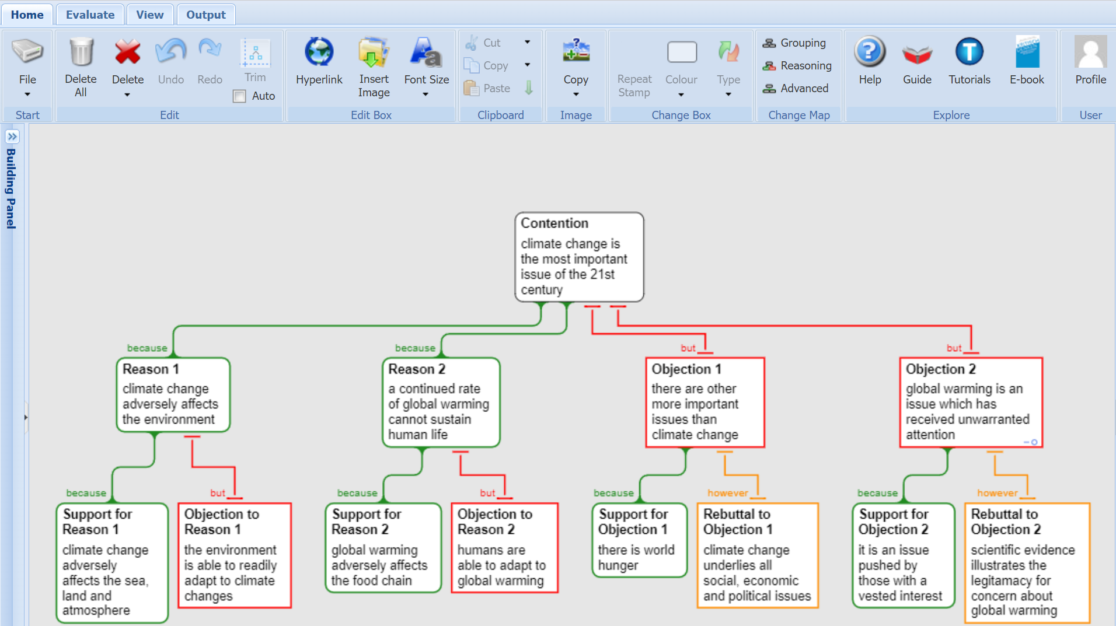
Dialogue mapping/argument mapping
Notes:
You can use tools such as facilitated discussions and dialogue mapping or argument mapping. Rationale is software designed specifically for argument mapping However, you can also use mind-mapping software, intended for creating and sharing ideas Products include: MindMeister, Lucidchart, XMind, Compendium, and Argunet.
If you feel the need If the workshop discussion has moved into the area where you would benefit from tools for argument mapping, then you probably need to stand back and take stock of the situation.
If you do decide you want to use an argument mapping approach, then trial out whatever tool you plan to use with a friendly audience first.

Slide 49
LUNCH

Slide 50
Explore 2nd candidate intervention
Notes:
Repeat the same process you used for the first candidate intervention.
You do not need to spend as much time selecting the candidate intervention, as everyone is familiar with the interventions from previously.

Slide 51
Explore 2nd candidate intervention
Select candidate intervention (5 minutes)
Facilitated discussion and activities (60 minutes)
Useful workshop techniques (15 minutes)

Slide 52
BREAK

Slide 53
Explore 3rd candidate intervention
Notes:
Repeat the same process you used for the first and second candidate interventions.
You do not need to spend as much time selecting the candidate intervention, as everyone is familiar with the interventions from previously.

Slide 54
Explore 3rd candidate intervention
Select candidate intervention (15 minutes)
Facilitated discussion and activities (60 minutes)
Useful workshop techniques (15 minutes)

Slide 55
Summary and Next Steps

Slide 56
Summary and next steps
Notes:
Summarise the main points of this workshop.
Identify the main points from each of the three candidate interventions.
If at all possible, seek to get agreement on the next step. This step should be to run one of the three interventions as a pilot solution.
If that is not possible, or is not agreed, then keep pressing the workshop attendees until you do get a next step, even if it is further investigation.
If you close this workshop without a clearly defined next step, you run the very real risk that the technical debt initiative will peter out and may require restarting.
You may need to run additional solution development workshops. They do not need to take a whole day, but if appropriate could be as short as 90 minutes.

